Slide 1



University Event Management System
TEAM-15
Aditya Yendhe- 002051157
Atharva Tanaji Hambir - 002058951
Raksha Krishna Moorthy - 002341520
Sachin Ramesh Shet- 002316078
Varana Natvarlal Navadiya-002308207

Slide 2

Objectives
1
﻿﻿Summary of the Problems Being Addressed
﻿﻿Challenges in event planning (venue booking, resource allocation, attendee management).
﻿﻿Inefficient tracking of attendance, ticketing and sponsorships.
2
Goals
﻿﻿Create a centralized platform for organizing and managing university events.
﻿﻿Improve communication between attendees and organizers.
﻿﻿Ensure efficient resource allocation and financial tracking.

Slide 3
High-Level Design
1
Design Considerations
2
Approach
﻿﻿Modular design to handle user roles (Student, Faculty, Admin).
﻿﻿Entity-Relationship (ER) modeling for database design.
﻿﻿Support for multiple events, resource allocation and venue reservations.
﻿﻿Use of normalization to avoid redundancy.
﻿﻿Secure payment and sponsorship management.
﻿﻿Integration of GUI and reporting tools for usability and insights.

Slide 4
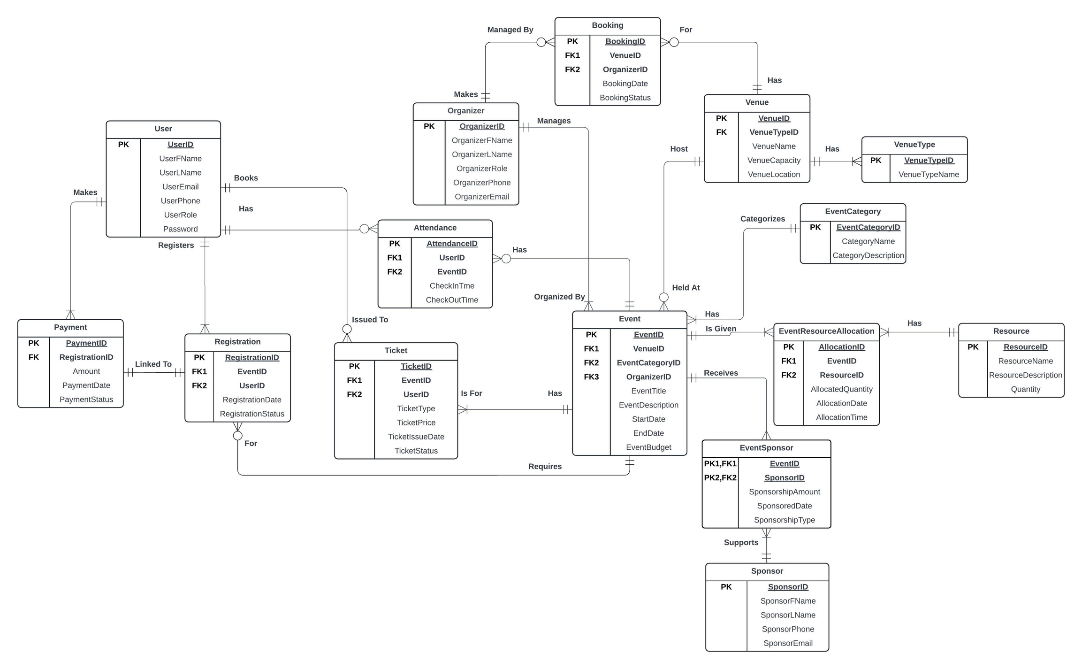
E-R Diagram

Slide 5
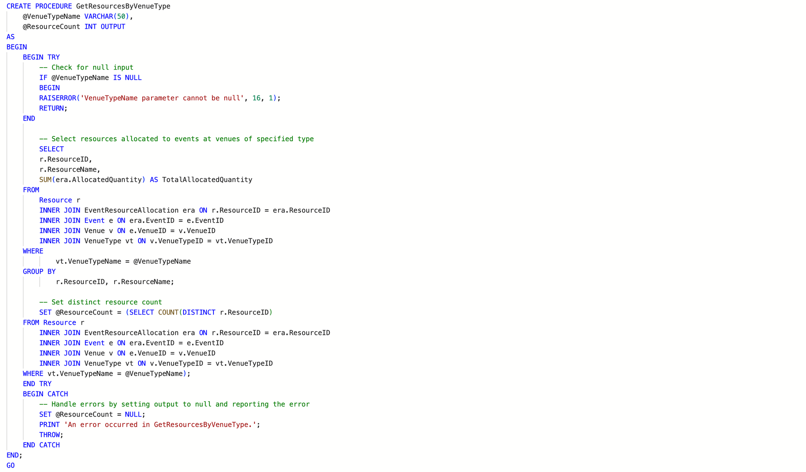
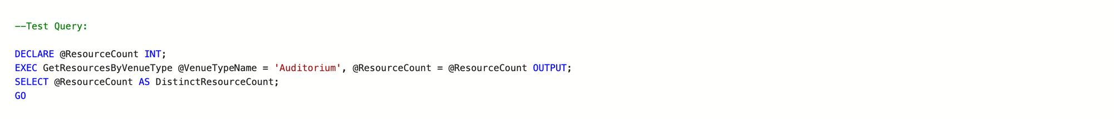
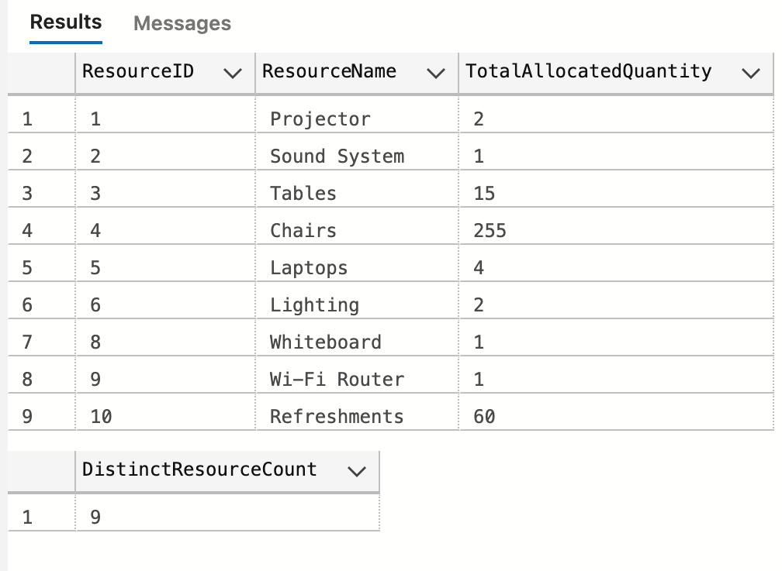
Database Objects
Stored Procedure
Lists all resources allocated to events held at venues of a specified type

Slide 6
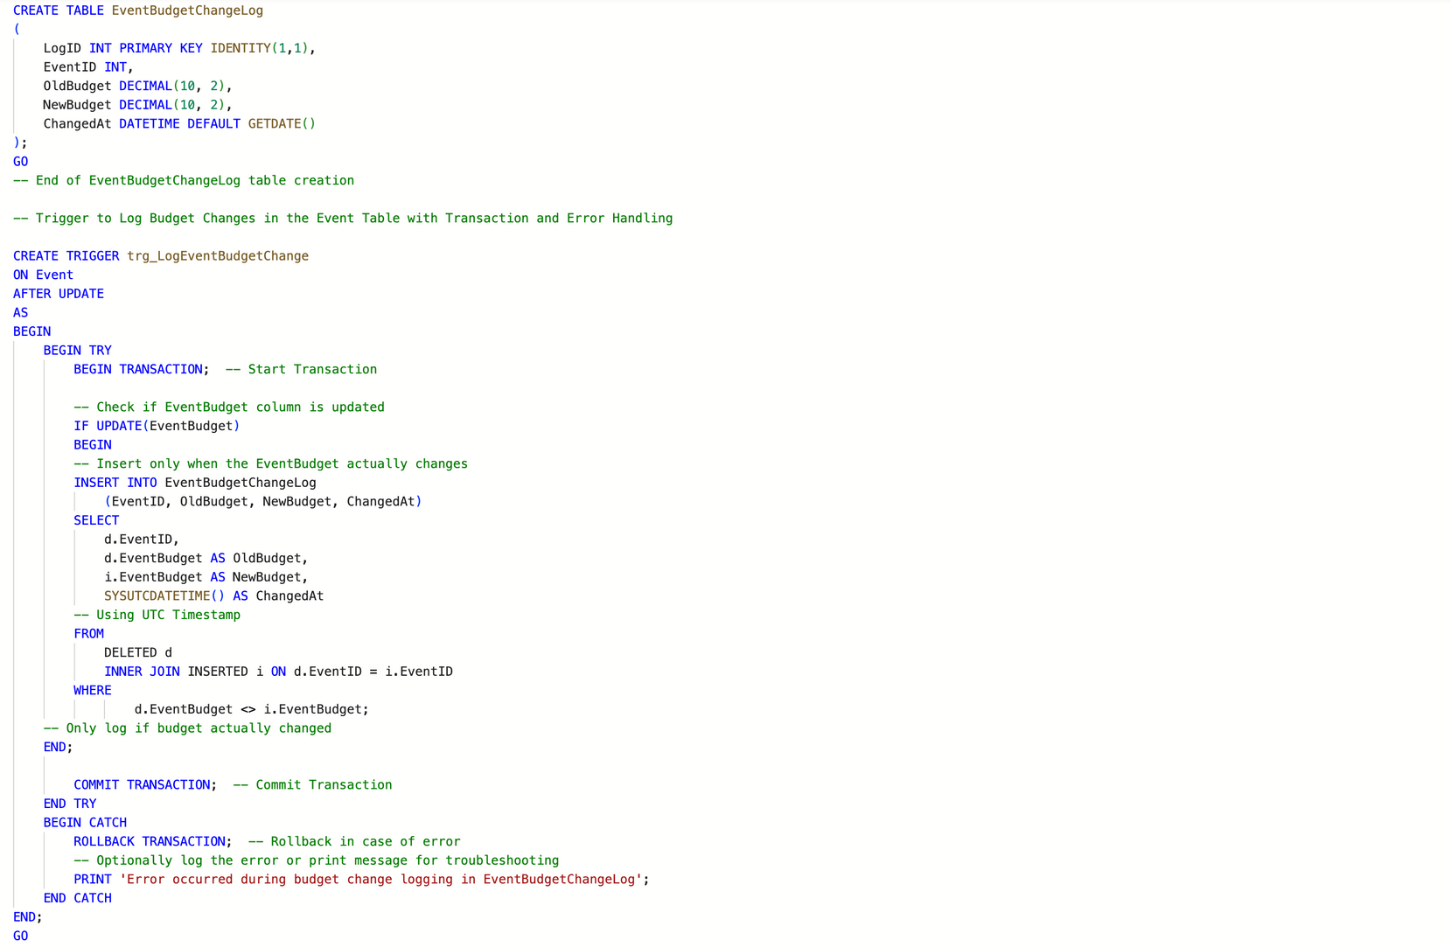
Database Objects
Trigger
Trigger to Log Budget Changes in the Event Table

Slide 7
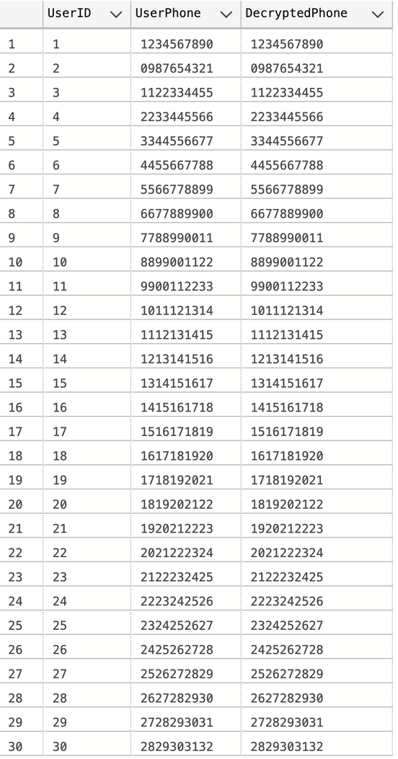
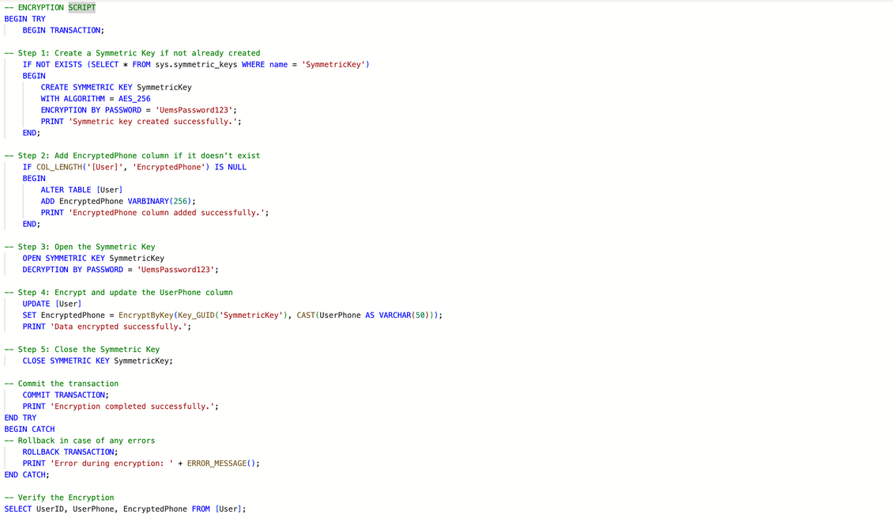
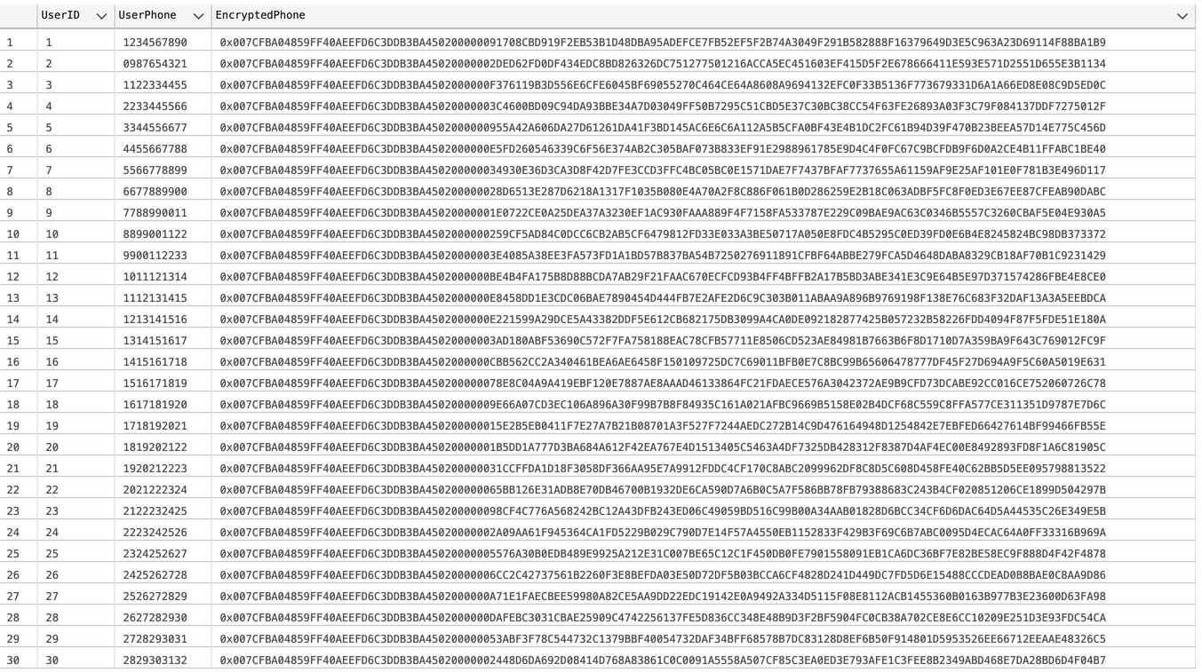
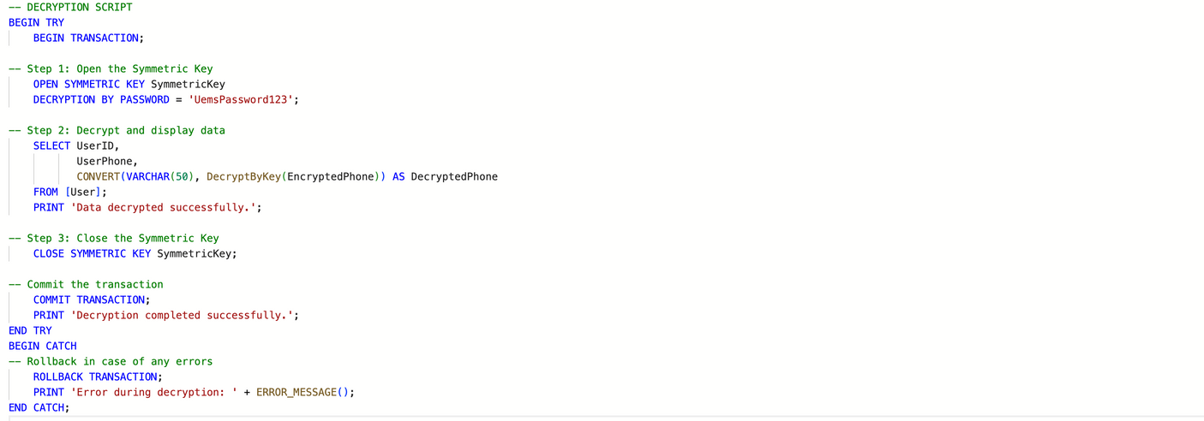
Database Objects
Encryption and Decryption

Slide 8
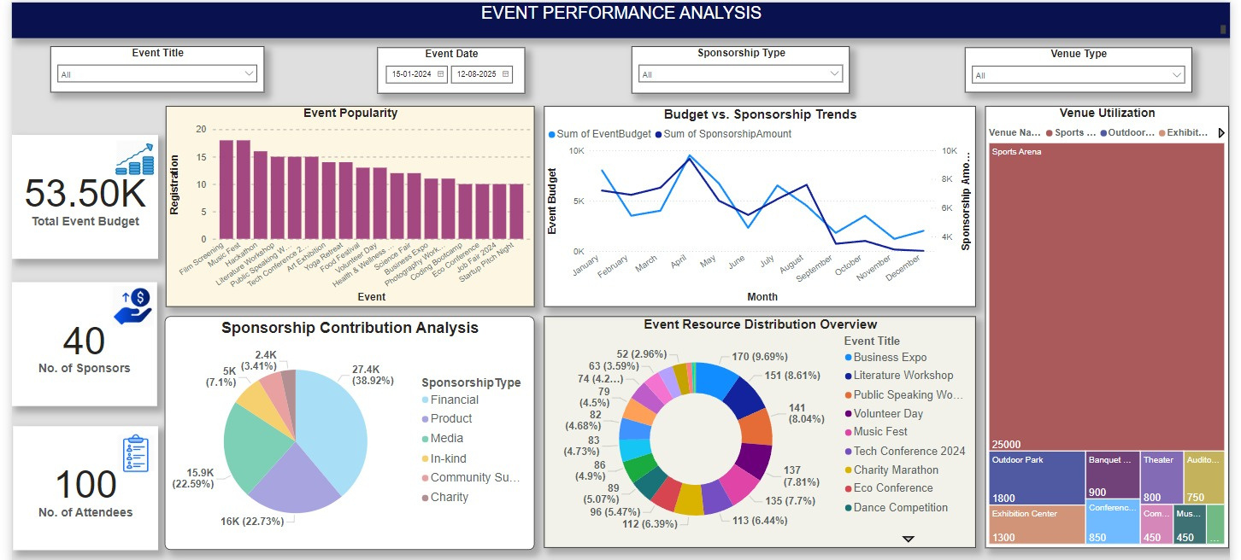
Dashboard

Slide 9
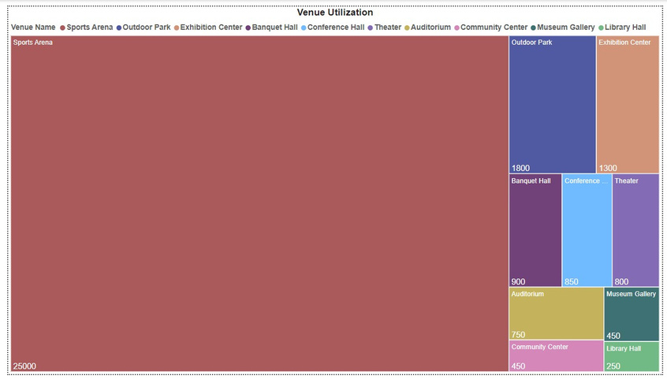
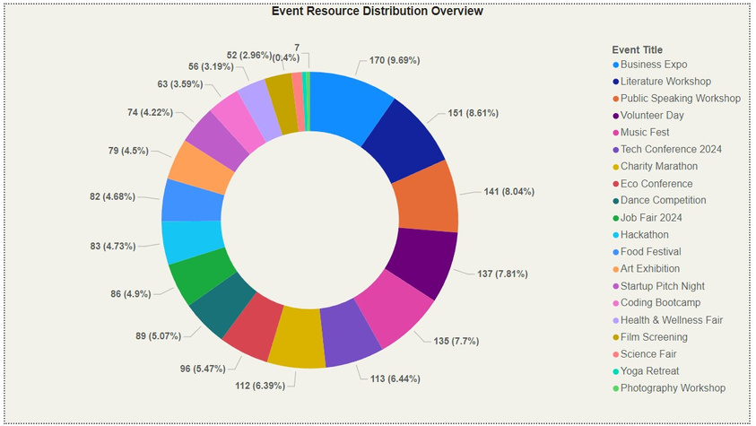
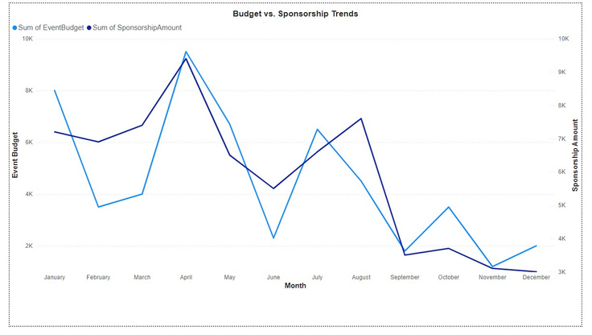
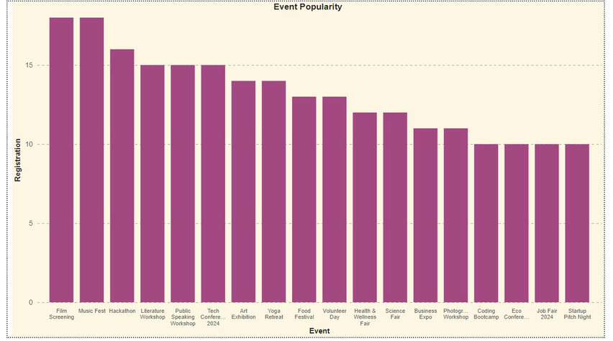
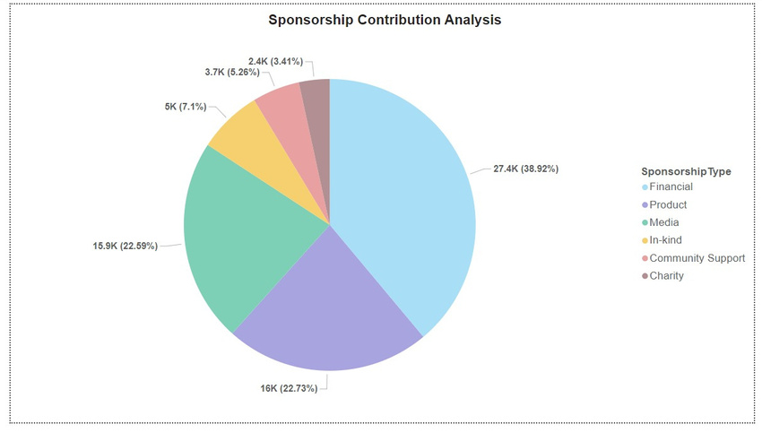
Power BI Reports
Visualization Utilization
Event Resources Distribution Overview
Budget Vs Sponsorship Trade
Event Popularity
Sponsorship Contribution Analysis

Slide 10
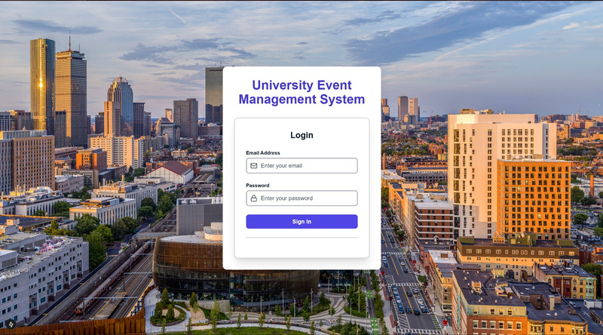
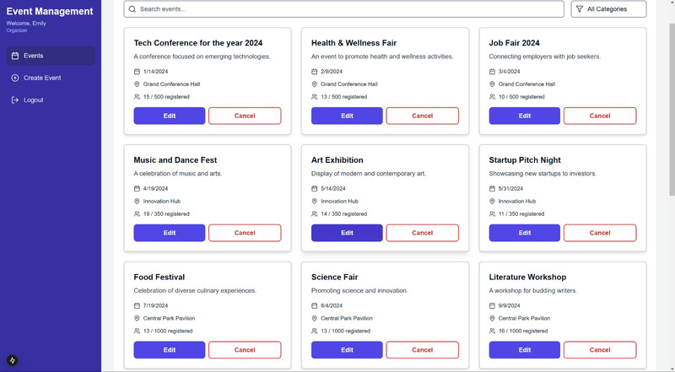
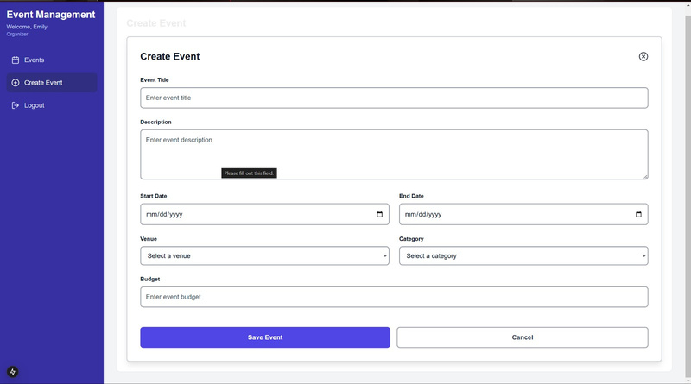
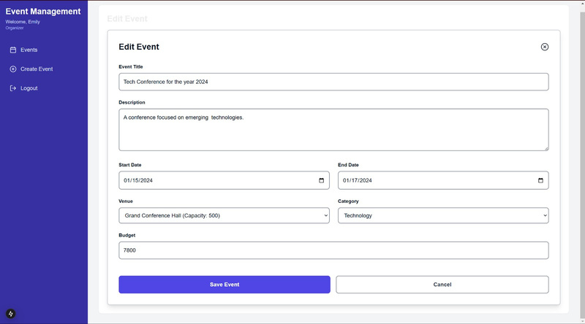
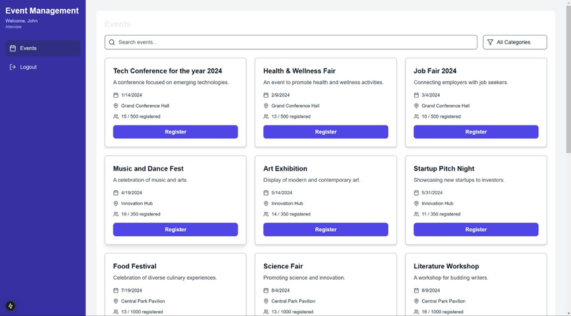
Graphical User Interface

